Slide 1
Azure Lab: “Vnet Peering and Connectivity Test”
# Objective: Set up and test network connectivity between two virtual networks (VNets) in Azure using VNet peering and Network Watcher.
# Resources Created:
2 Vnets
“Core-Vnet” : 10.30.0.0/16 (ARM Template) & “Stg-Vnet”: 10.40.0.0/16
2 Virtual Machines
“Core-VM” in “Core-Vnet” & “Stg-VM” in “Stg-Vnet”
Test Connectivity between 2 VM Using Network Watcher
Configure VNet Peering from “core-vnet” to “stg-vnet”
Test connectivity again to confirm successful peering
# Tools Used:
Azure Portal | Network Watcher | ARM Template (for Core-Vnet)

Slide 2
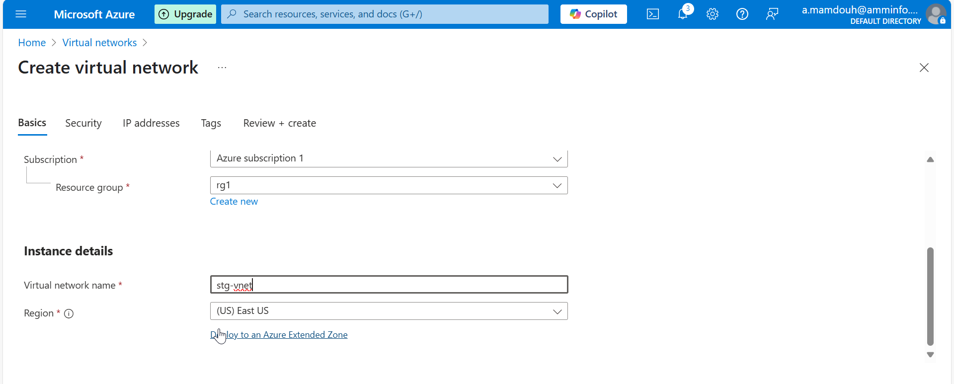
Notes:
Create RG & Vnet

Slide 3
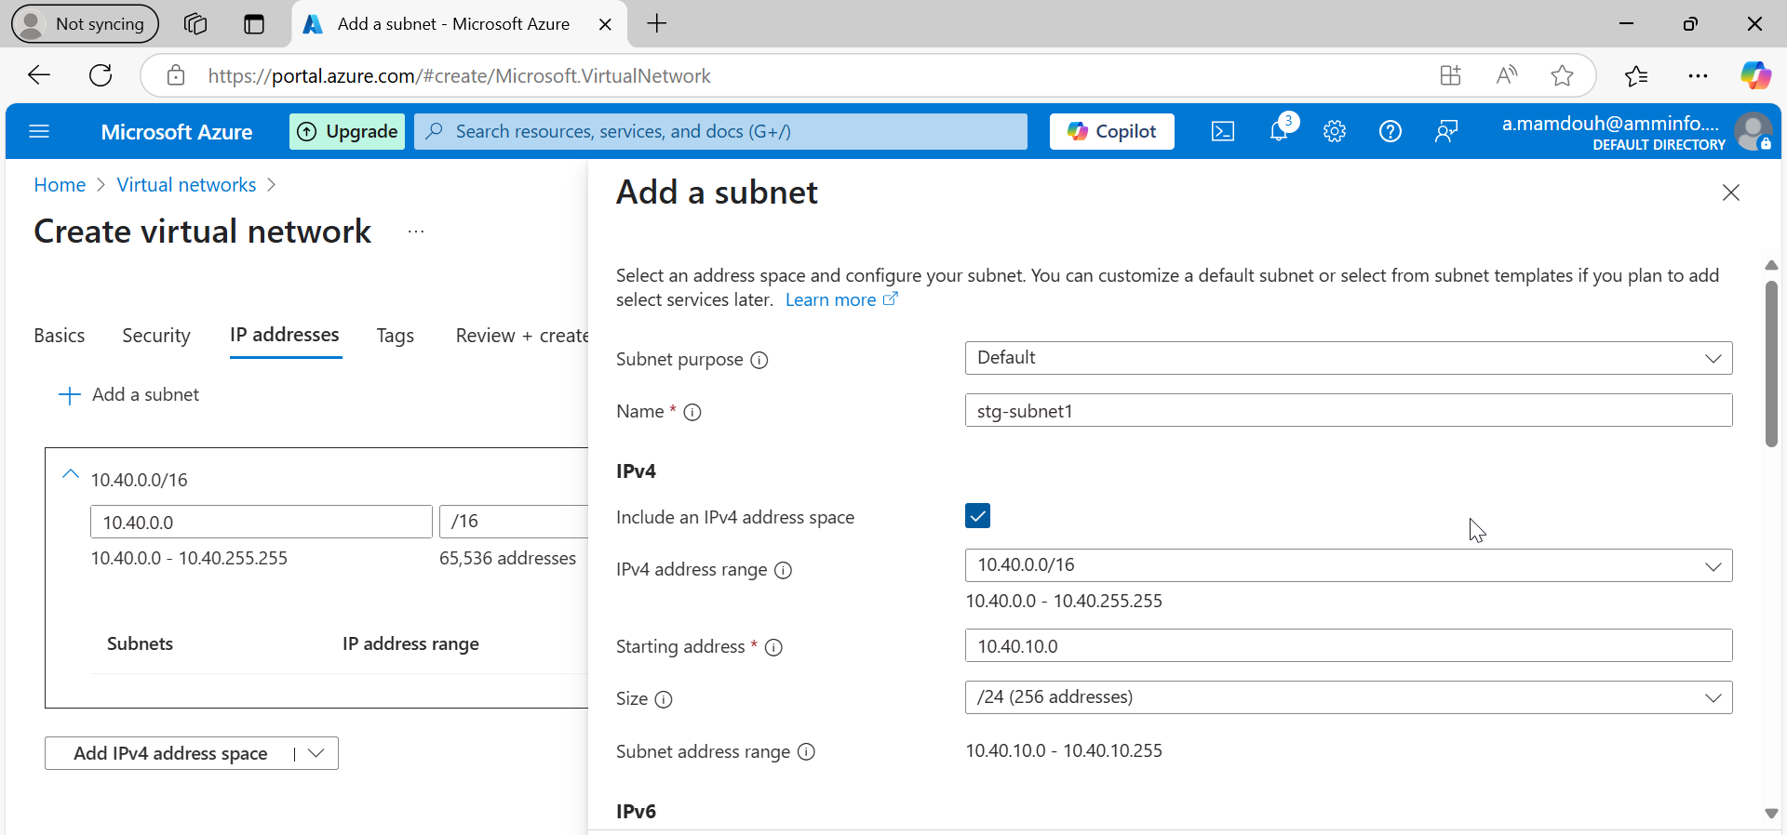
Notes:
Create stg-vnet with address space 10.40.0.0 /16 & 2 subnet

Slide 4
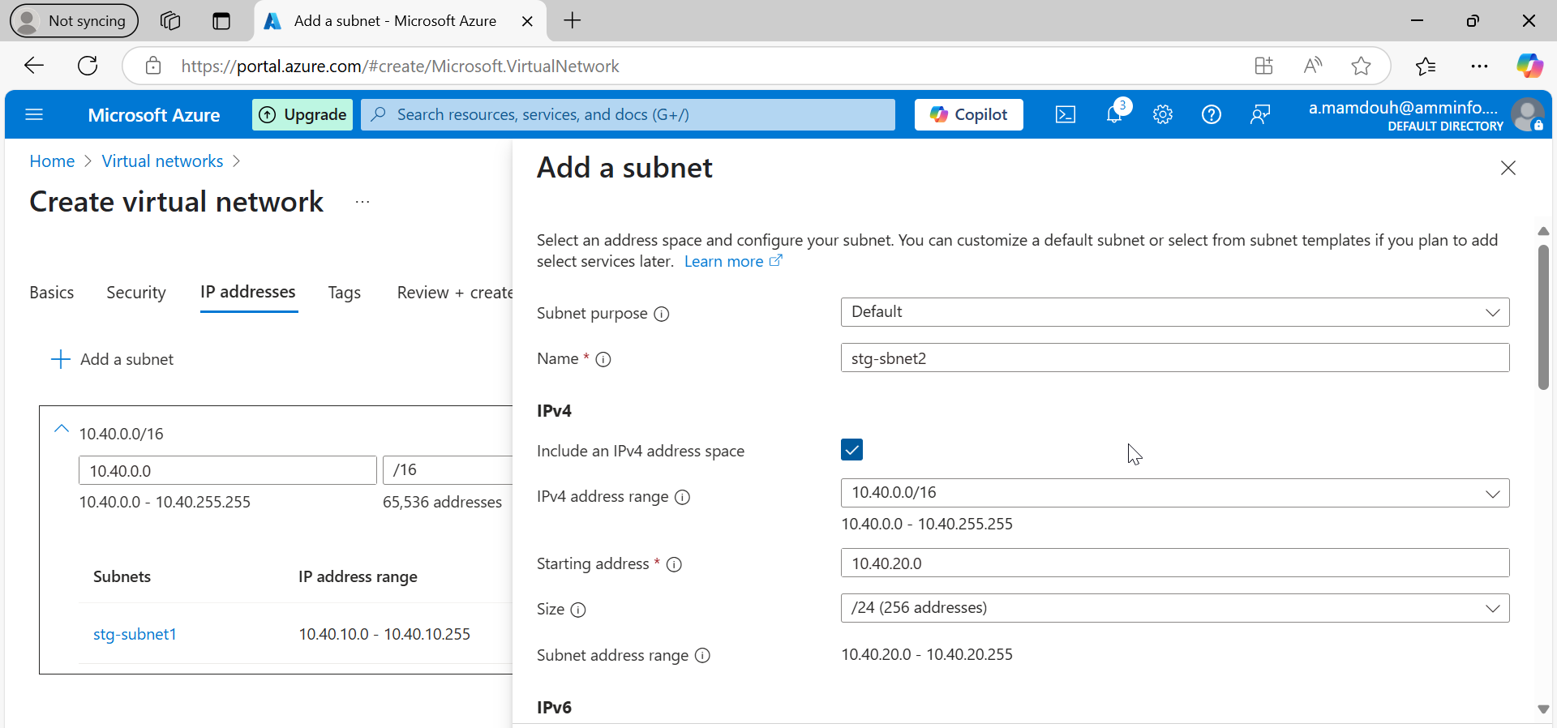
Notes:
Add a second subnet

Slide 5
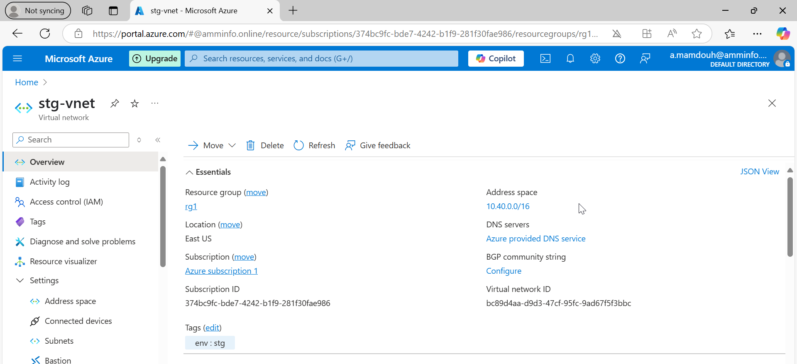

Slide 6
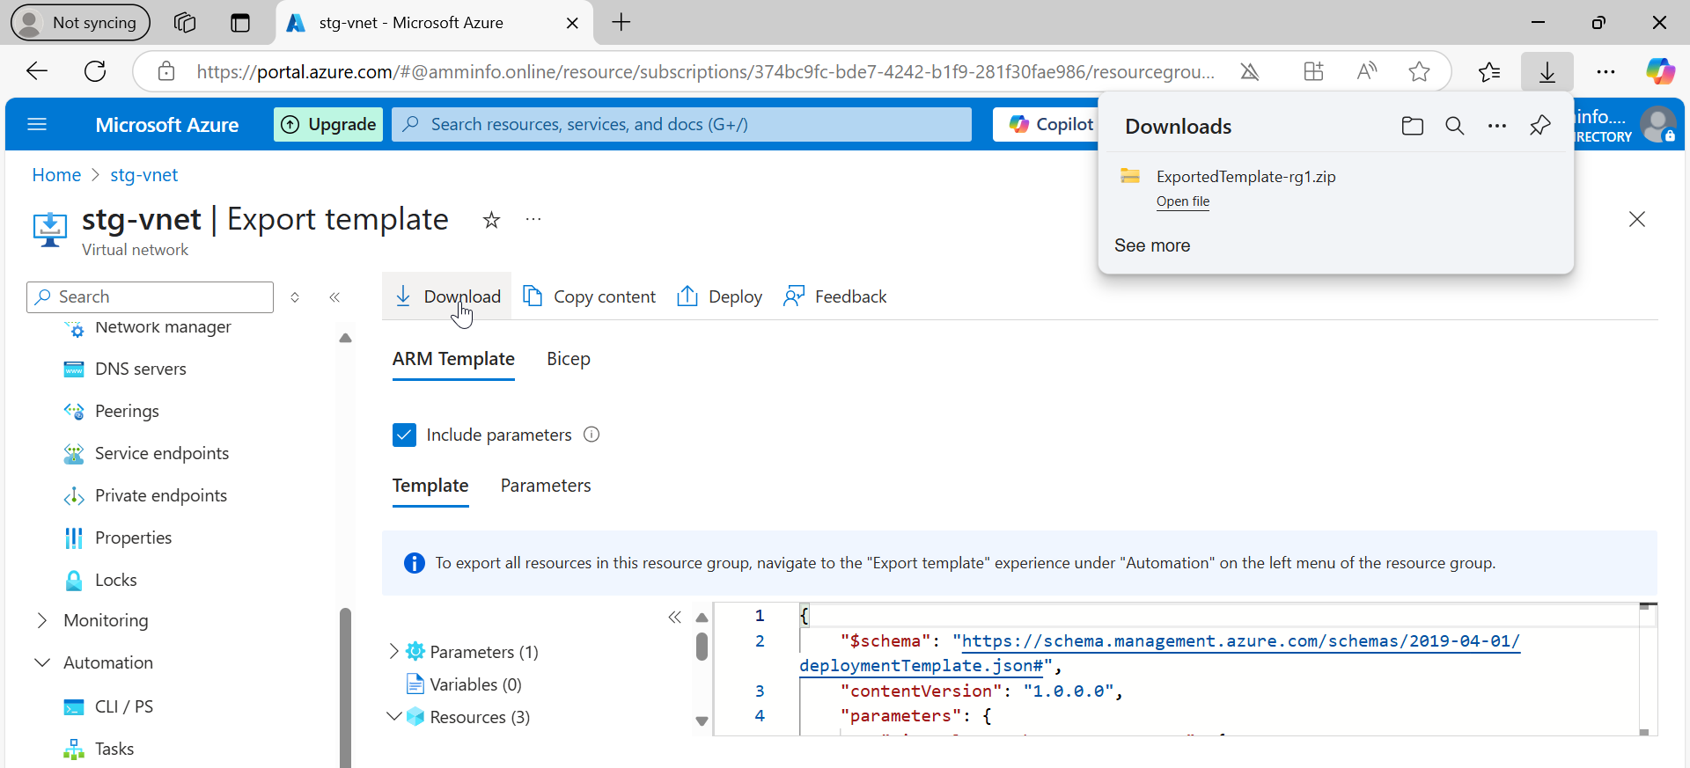
Notes:
Export ARM template from stg-vnet which I created via portal and download it locally and then editing its parameters such as vnet name-address psace – subnet

Slide 7
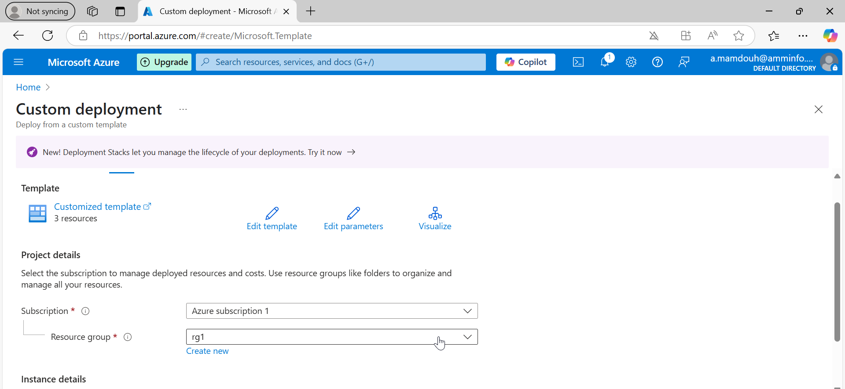
Notes:
Search for custom deployment to upload your json files after editing its parameters

Slide 8
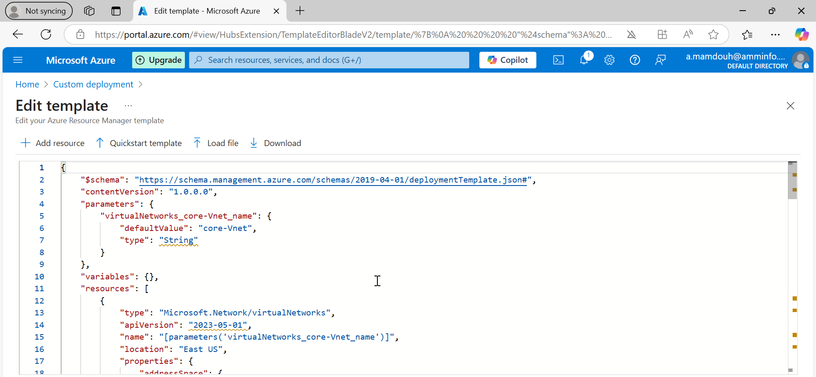

Slide 9
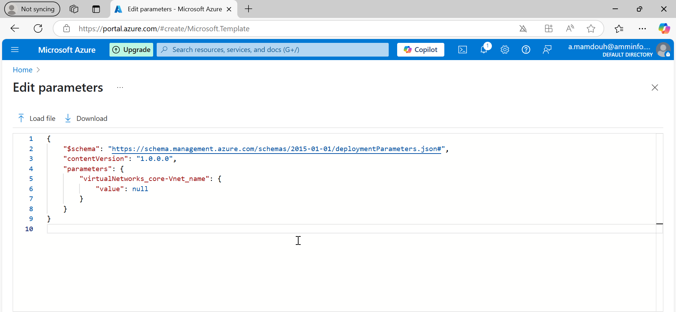
Notes:
Change parameters in Json like vnet name, add space and subnet

Slide 10
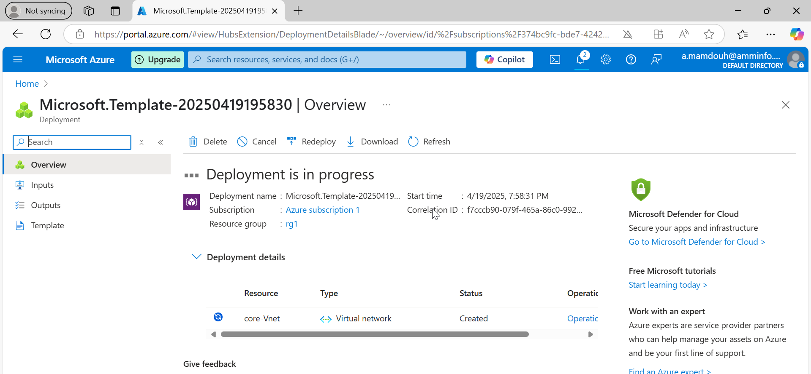

Slide 11
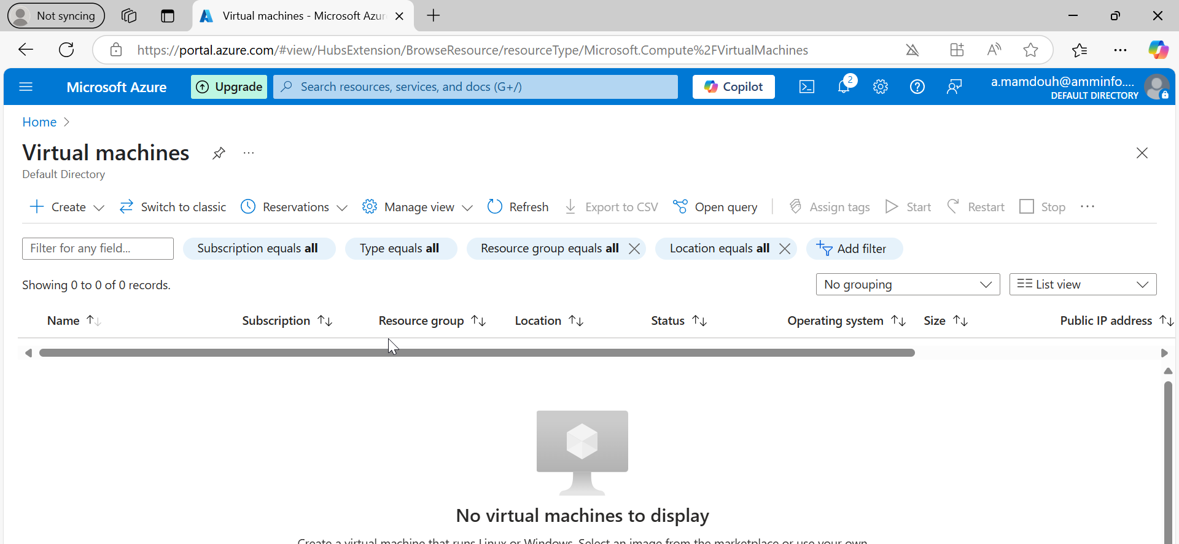
Notes:
Create a new vm

Slide 12
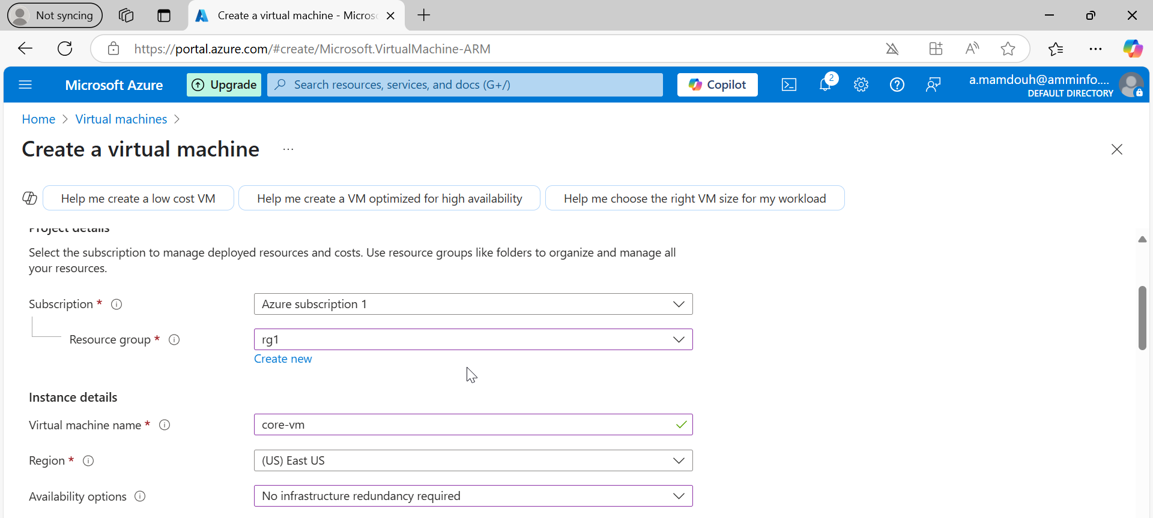
Notes:
Vm name “core-vm”

Slide 13
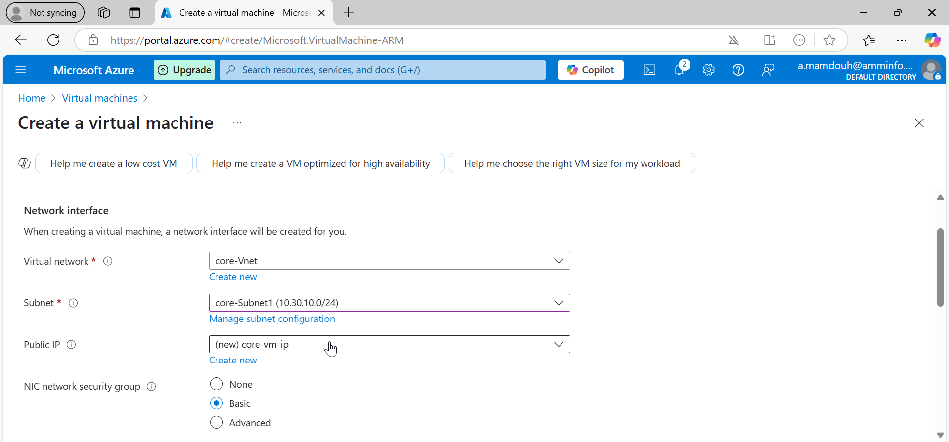
Notes:
Specify vnet and subnet for your vm core-vnet-subnet ”10.30.10.0”

Slide 14
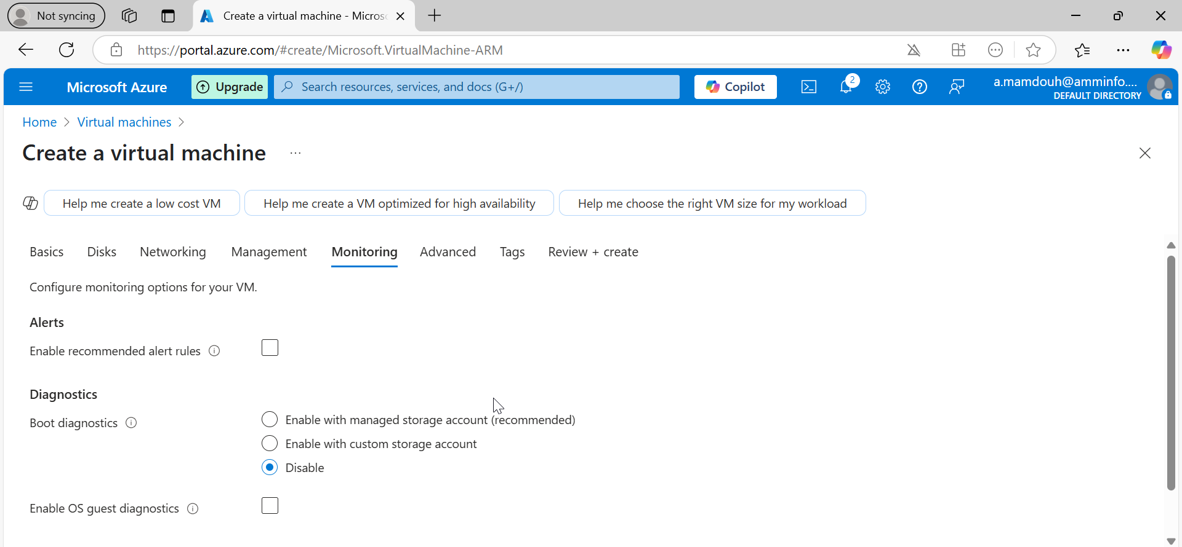

Slide 15
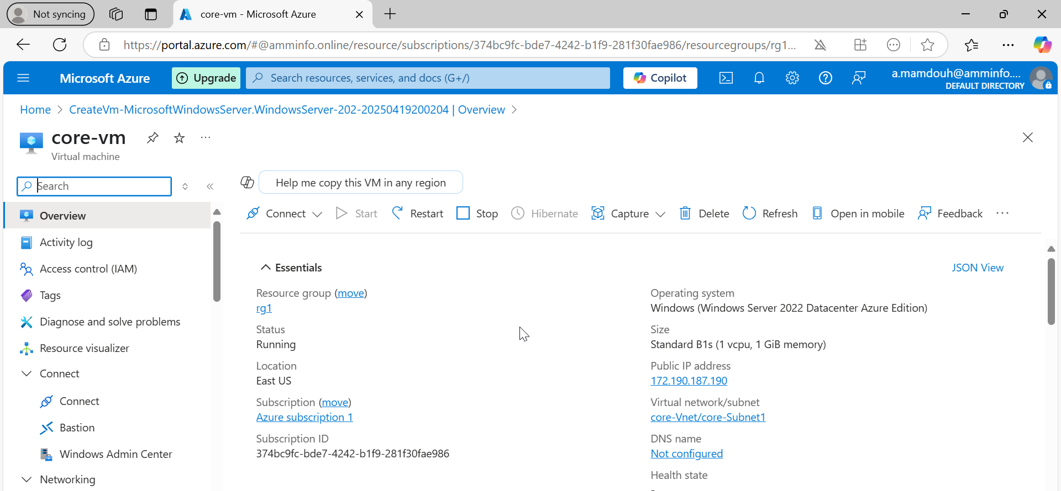

Slide 16
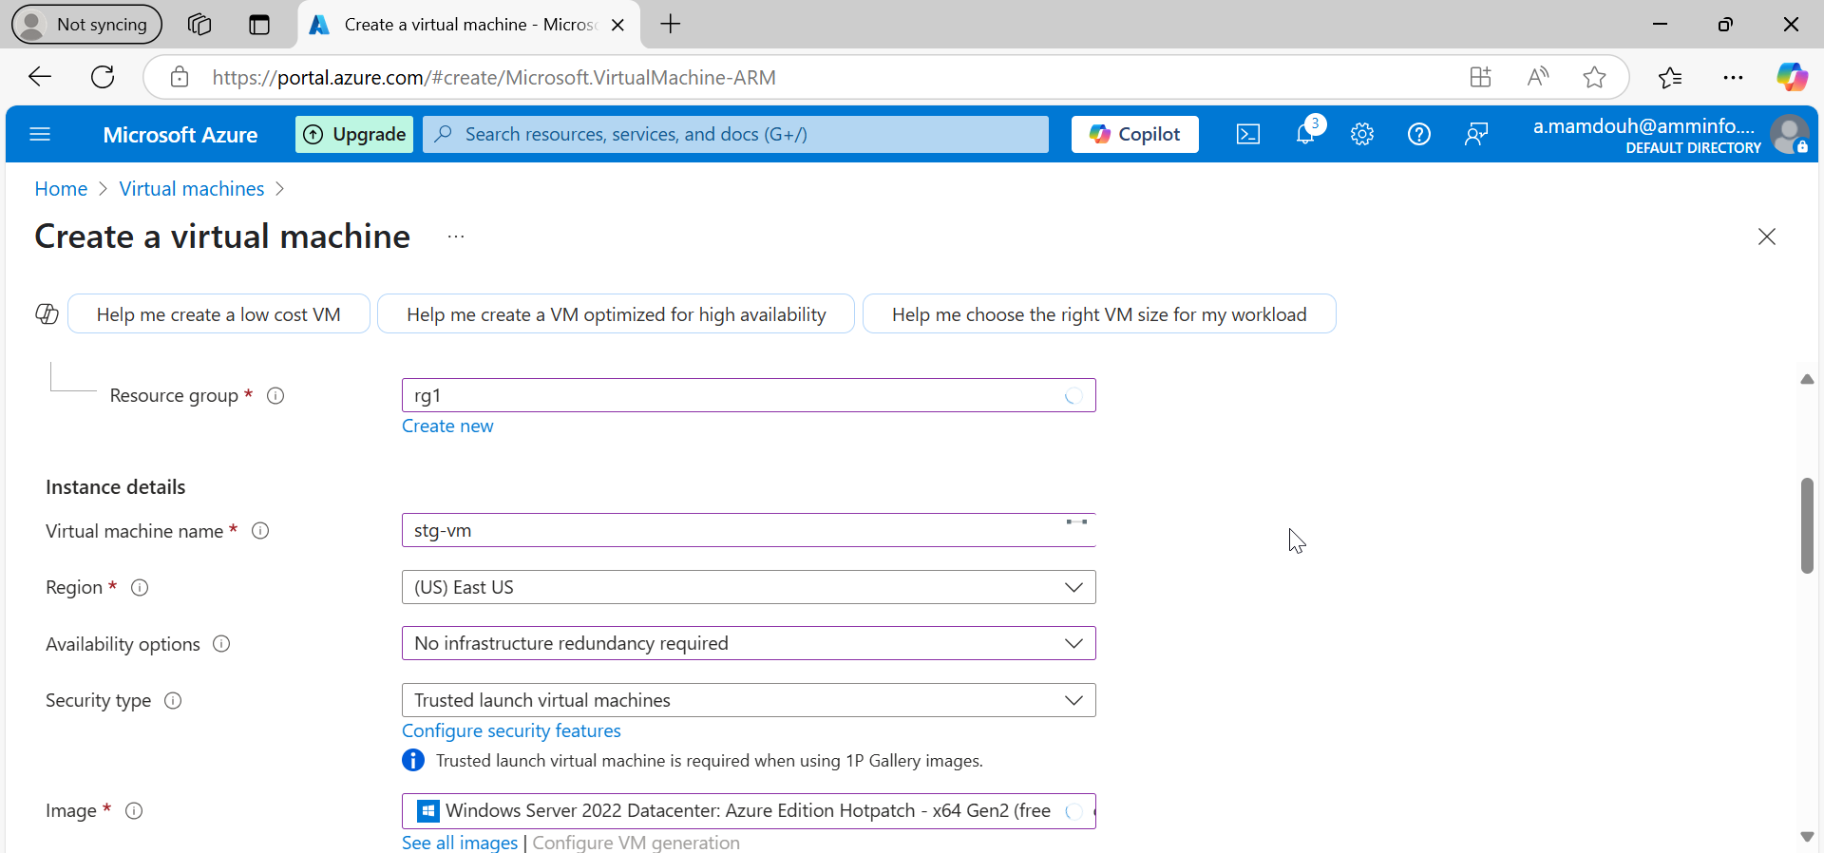
Notes:
Create a second vm “stg-vm”

Slide 17
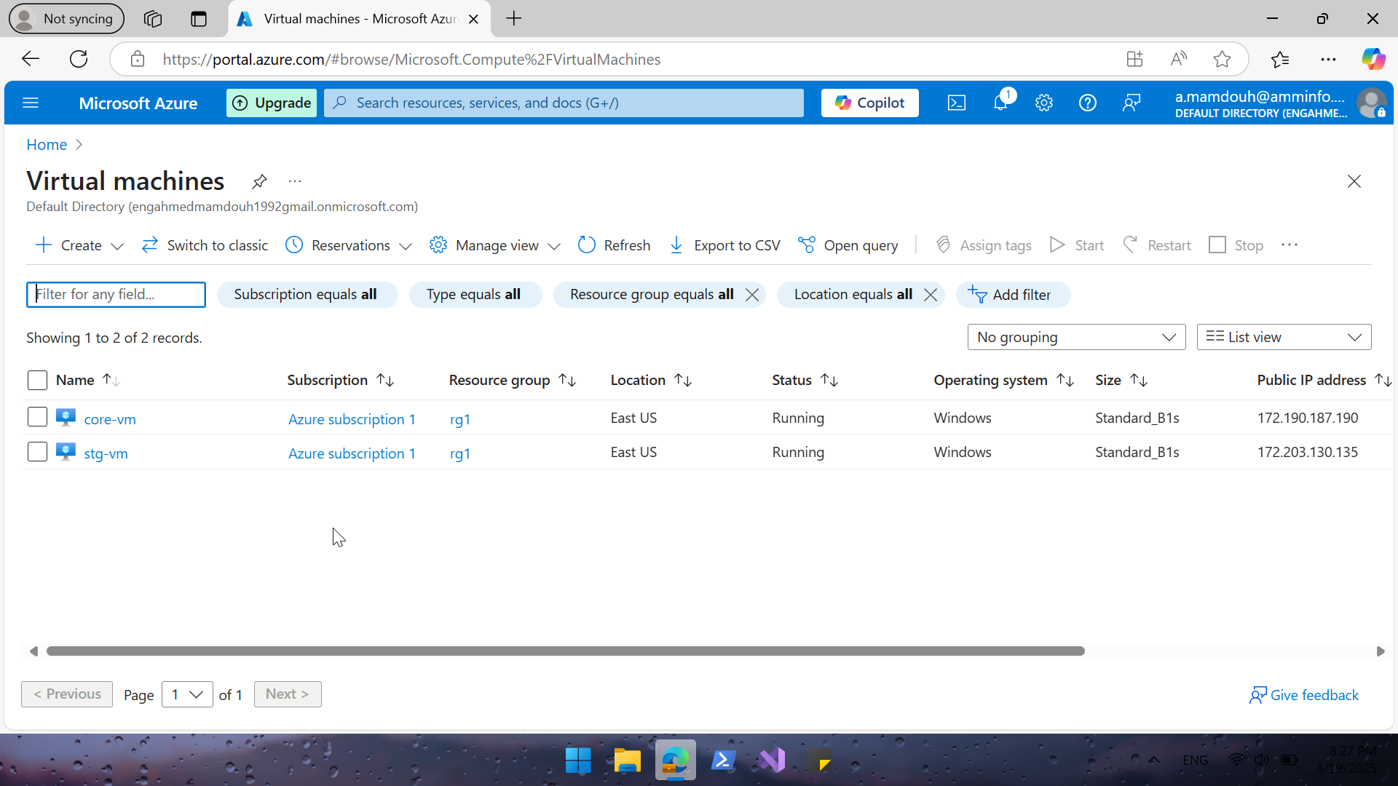
Notes:
vms are up and running

Slide 18
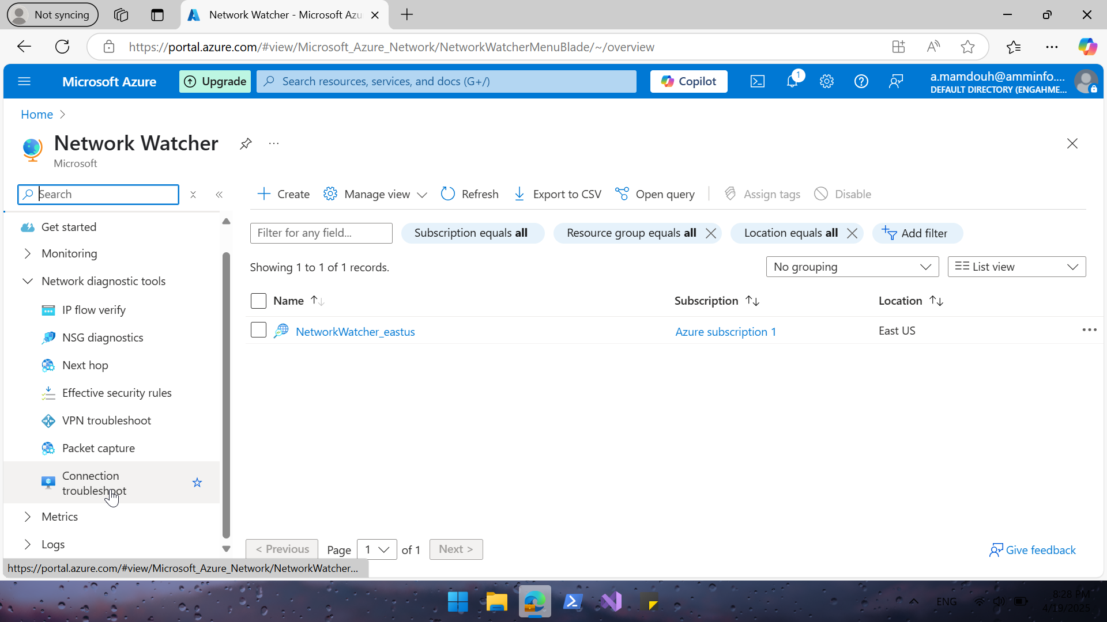
Notes:
Search for network watcher to test connectivity between 2 vms

Slide 19
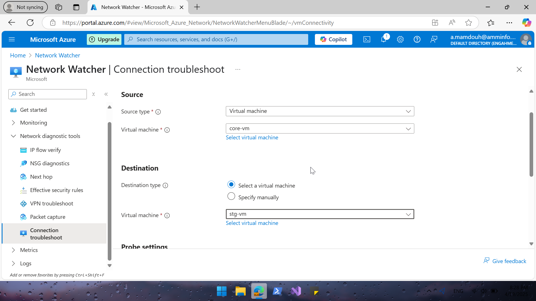
Notes:
Create connection troubleshoot to test connectivity between 2 vms

Slide 20
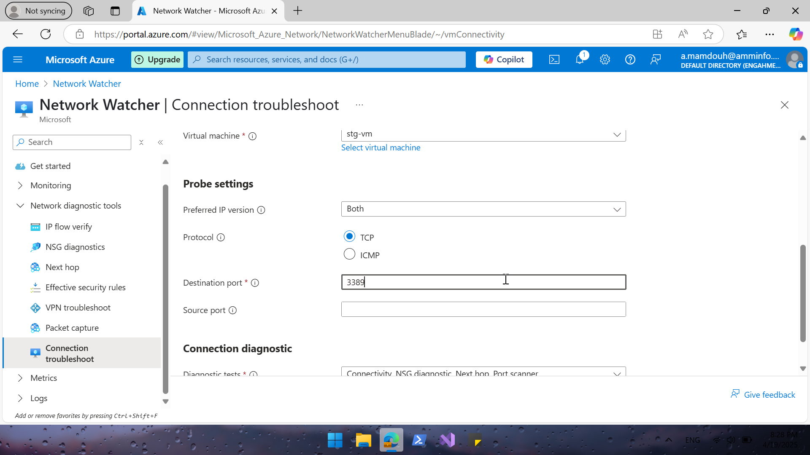
Notes:
test connectivity on 3389 (RDP)

Slide 21
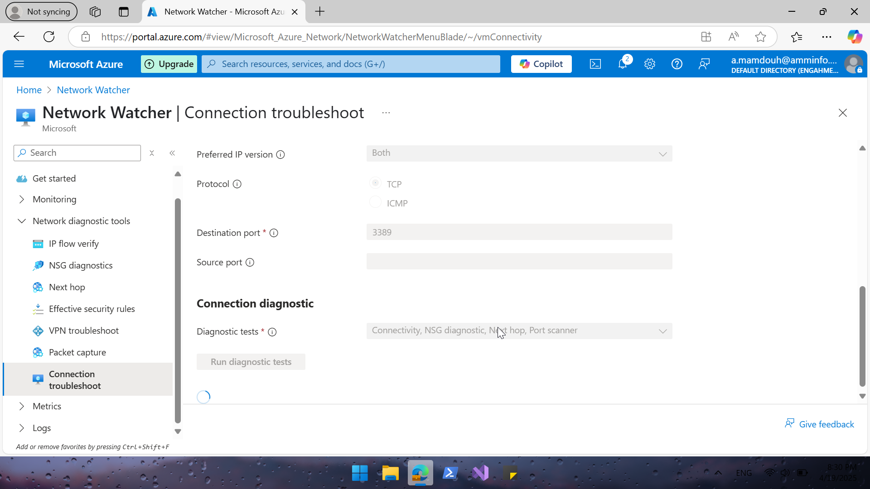

Slide 22
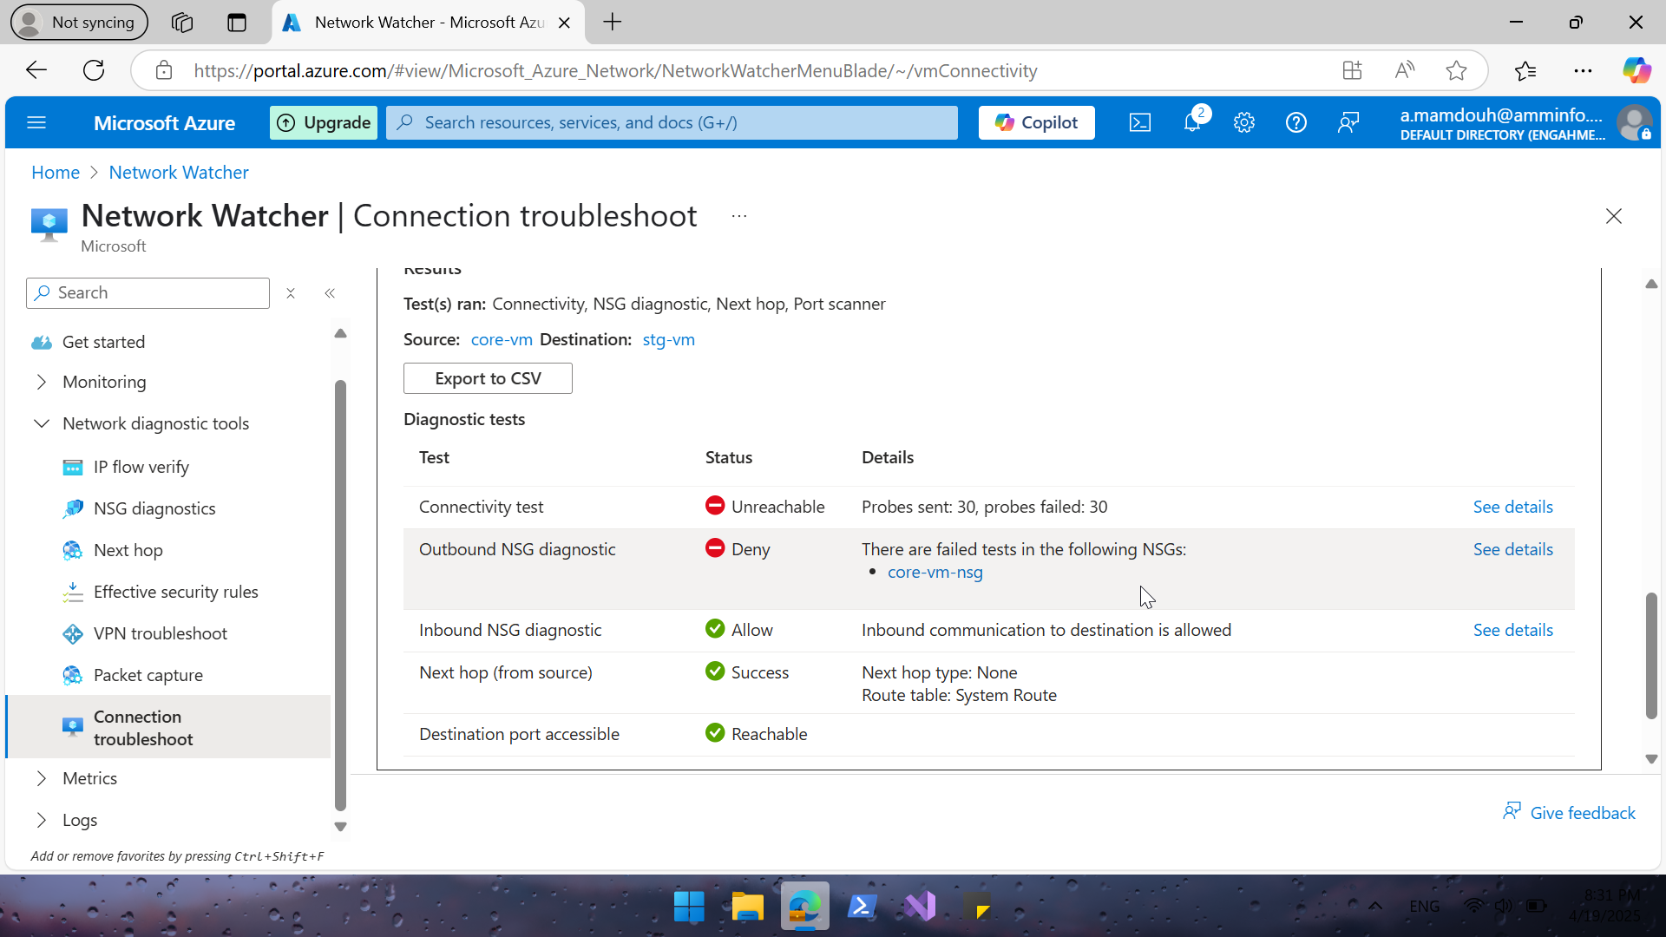
Notes:
Connection failed

Slide 23
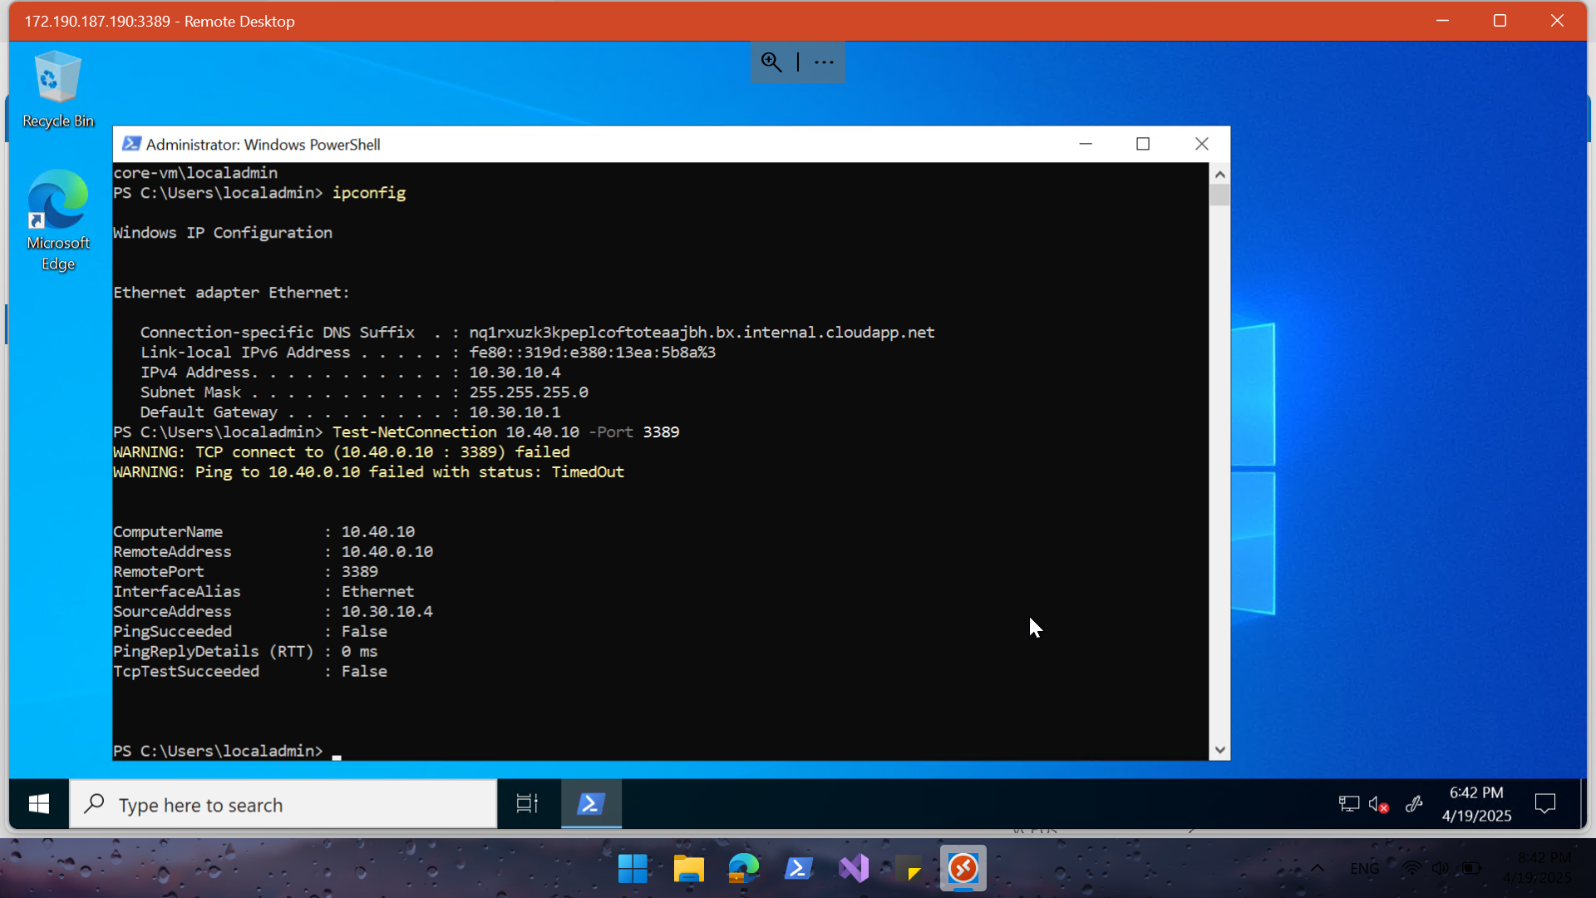
Notes:
RDP to core cm and use test-netconnection – port to test connection to Stg-vm in another vnet on port 3389 | connection failed

Slide 24
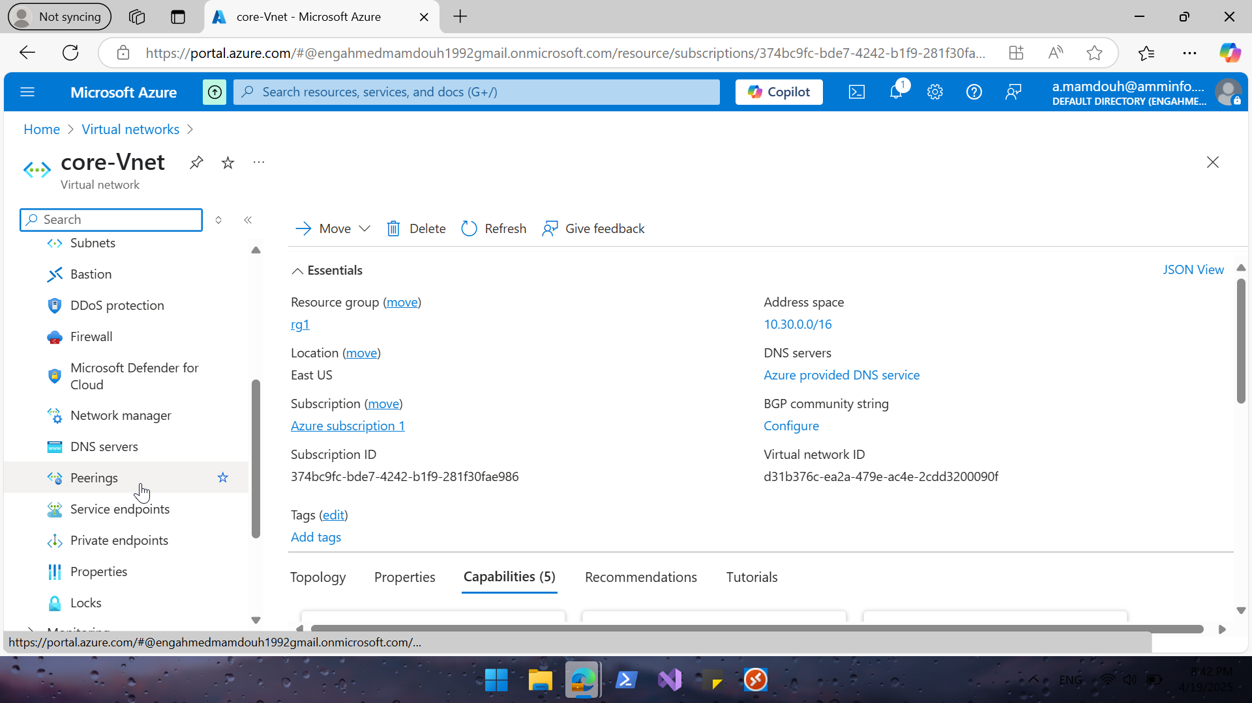
Notes:
Configure peering between 2 vnet "You can connect VNets to each other using VNet peering or a VPN gateway to enable communication between resources across different virtual networks

Slide 25
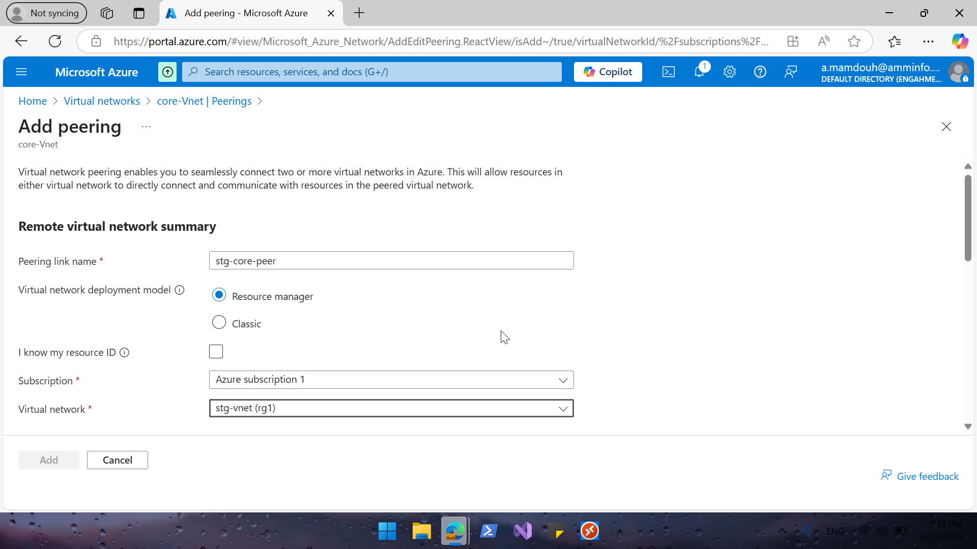
Notes:
Add remote vnet

Slide 26
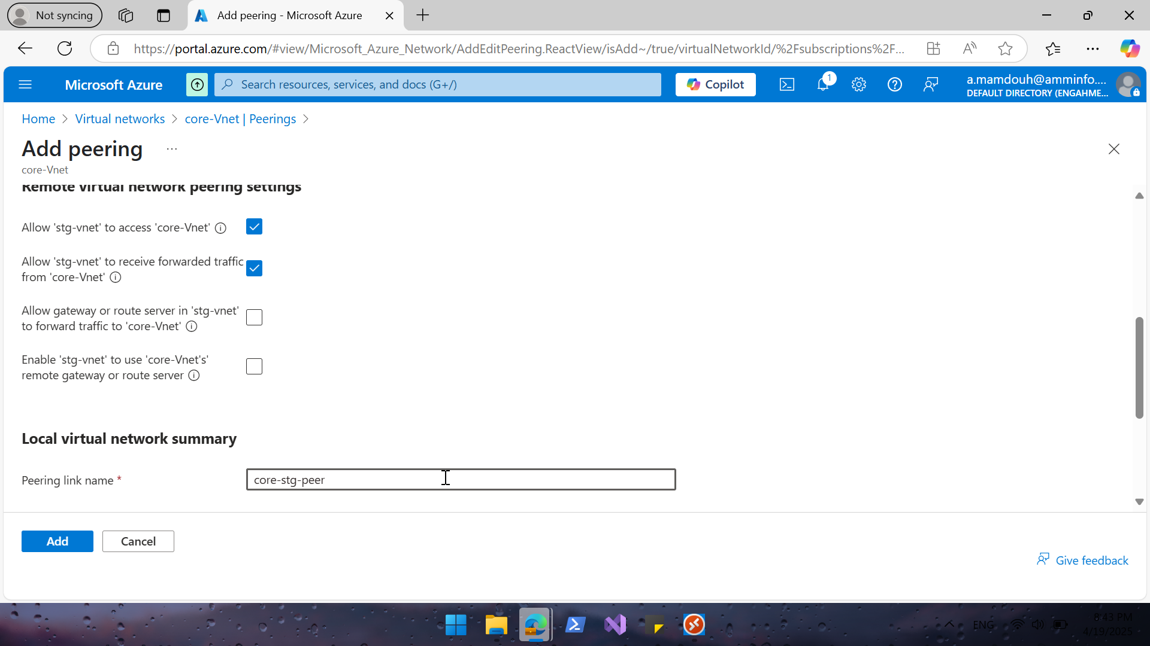
Notes:
Allow traffic on two ways

Slide 27
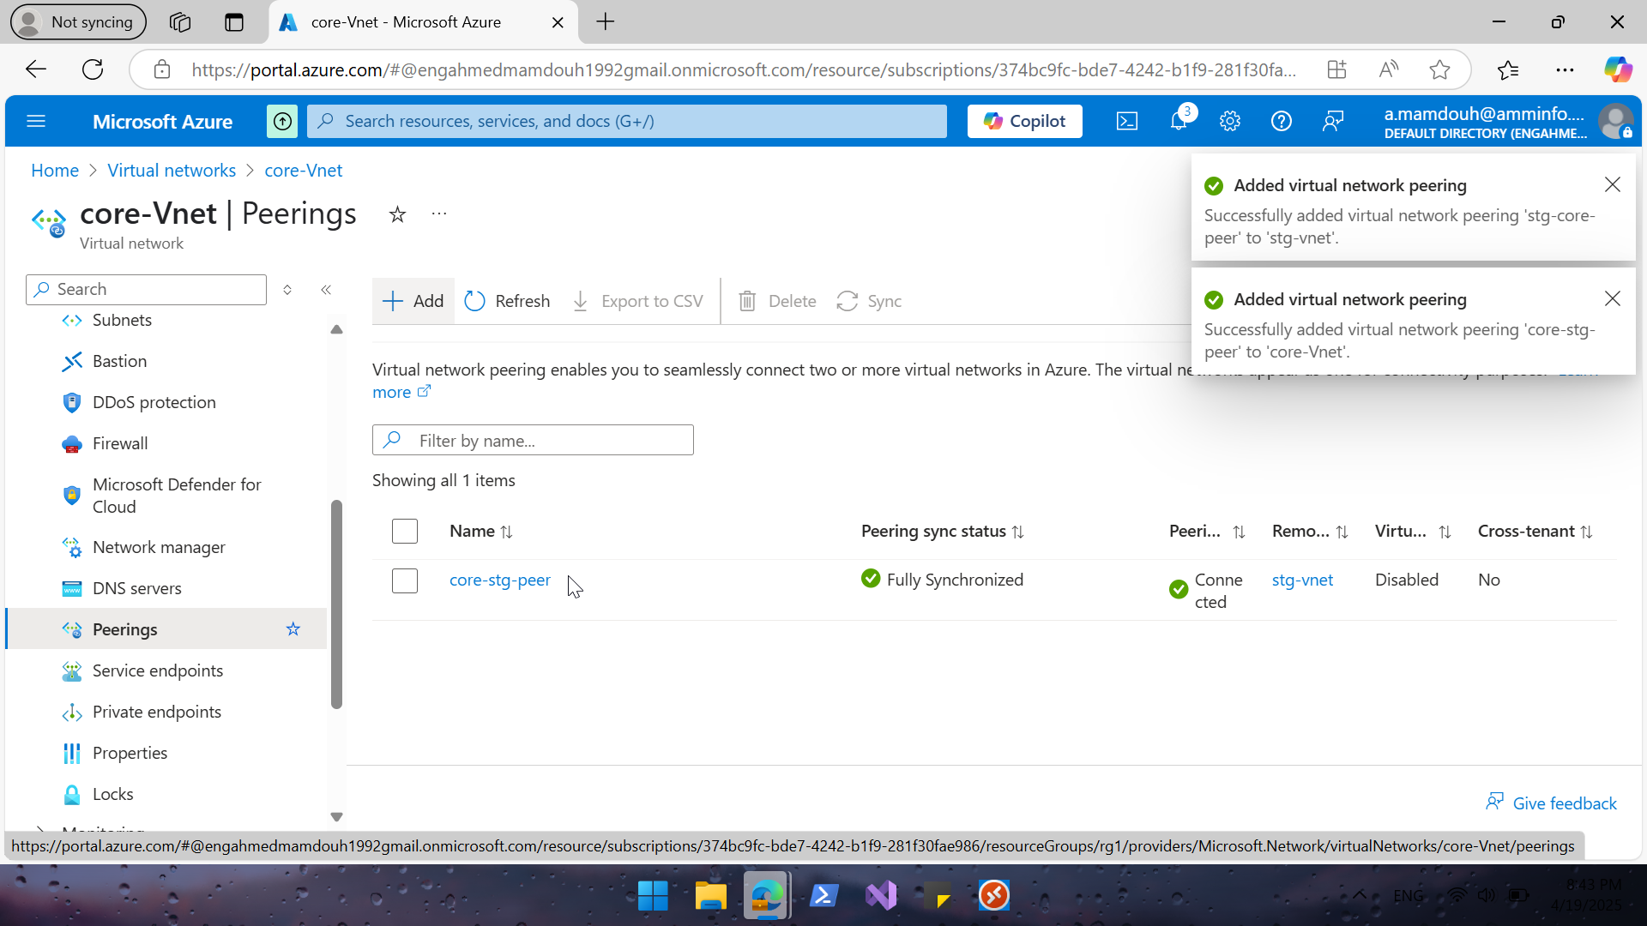
Notes:
Peering is configured

Slide 28
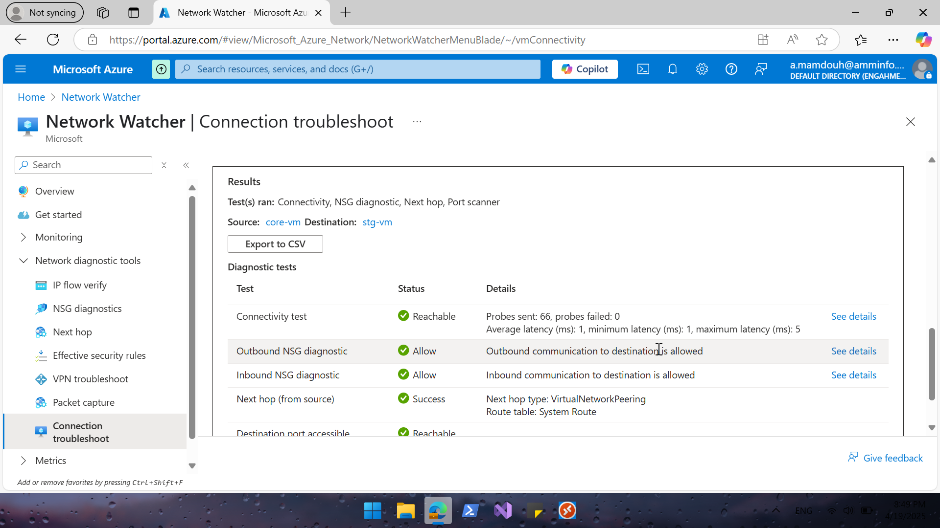
Notes:
Test connectivity between 2vm as before | connection succeeded

Slide 29
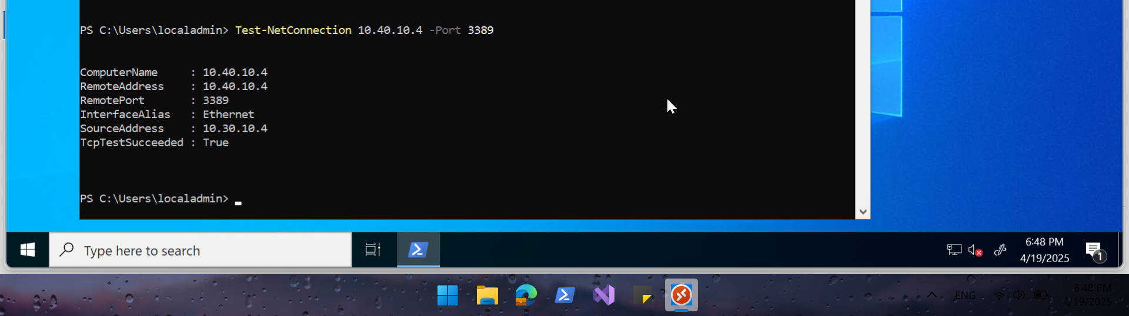
Notes:
Using test connection from a vm | connection succeeded

